Slide 1


CONSUMER COMPLAINTS ANALYSIS USING HIVE & COMPANY’S RESPONSE PREDICTION USING NAIVE BAYES
Team Members:
Ankit Basarkar
Manoj Gyanani
Nishant Goel

Slide 2

Notes:
Mr. Ted has started a startup and wants to choose a bank for his company’s accounts.
He not just want security but also best services.
He is very confused as you can see in the picture.

Slide 3

Notes:
So he asks his friend Mr. Joe for help.
Mr joe knows some students in SJSU who are analyzing the data on consumer complaints. So he says that he can forward the report of analysis done by them to him for assistance.
Lets see what the analysis is all about.

Slide 4


The data set is regarding the Consumer Complaints obtained by CFPB.
Freely available at : http://catalog.data.gov/dataset/consumer-complaint-database#topic=consumer_navigation
Notes:
Consumer Financial Protection Bureau
All the complaints are Finance related.
Complaints received by CFPB are forwarded to the company and work to get a response from them.
15 days to respond to consumer and cfpb and expect 60 days to close
They publish the database so that the world knows what complaints they receive.
Companies include banks , credit reporting agencies, other financial instituitions.

Slide 5

The Data
Date received
Product
Sub-product
Issue
Sub-issue
Company public response
Company
State
ZIP code
Submitted via
Date sent to company
Company response to consumer
Timely response?
Consumer disputed?
Complaint ID
Notes:
Sub Product : Mortgage : Conventional fixed Mortgage, FHA mortgage
Issue : Cont'd attempts collect debt not owed : Debt is not mine , Debt was paid

Slide 6
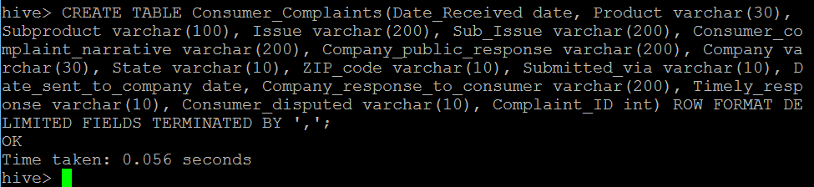
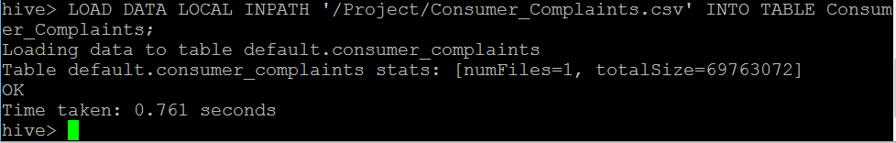
Create Table
Load Data

Slide 7
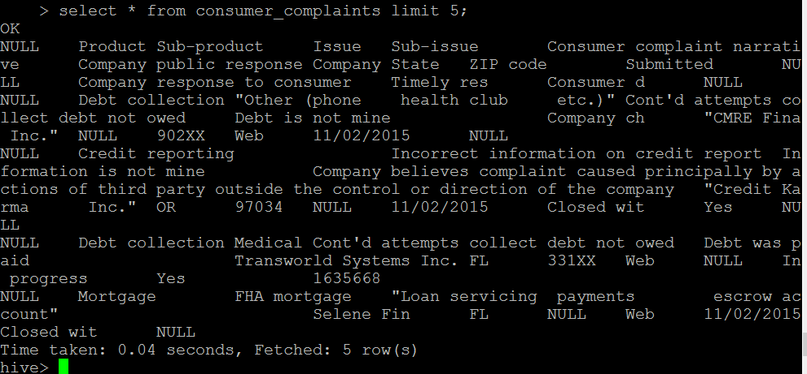
Lets test the data before doing some useful analysis

Slide 8


Slide 9

Let’s remove the header first

Slide 10

Having problem dealing with commas
Don’t worry custom serde is available

Slide 11


Slide 12
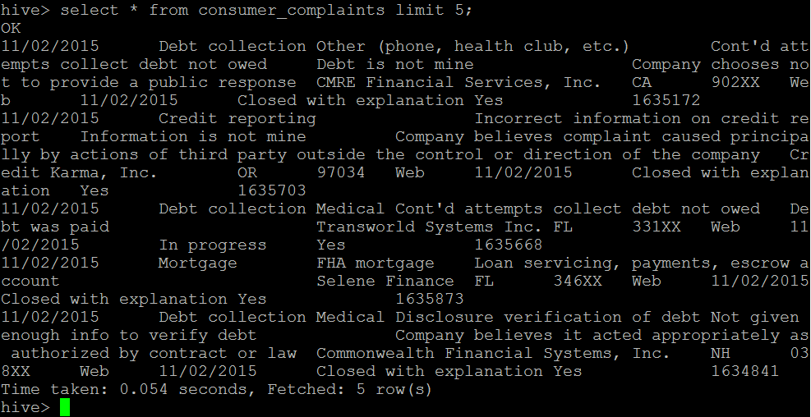

Slide 13
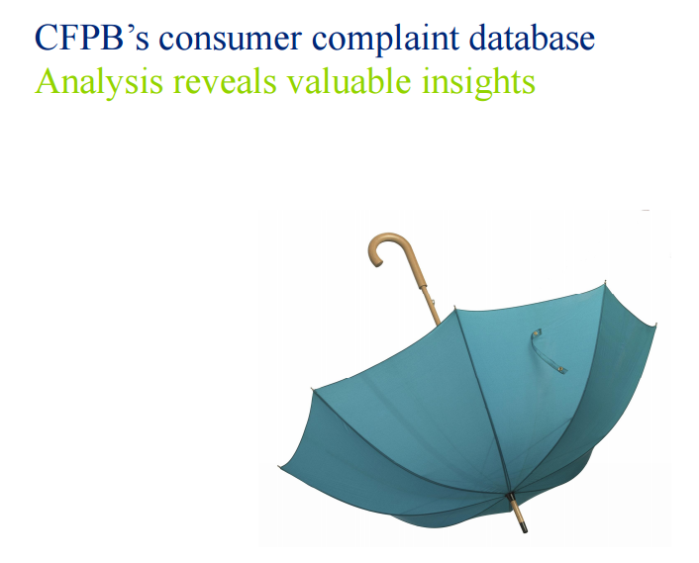


Notes:
I will talk about the results of the analysis we did on Consumer Complaints dataset.
We used Tableau and Google Charts for visualizing the results.

Slide 14



Financial Institutions : 3017
Total Complaints : 1,92,644
Closed Complaints: 1,87,956
Consumers (got timely response): 98%
Notes:
In our data set, there were 3017 financial institutions that included banks, credit reporting agencies, insurance companies and many more.
Approximately 192 thousand complaints were recorded in CFPB database from January 2014 till now.
There were approx 188000 complaints which got closed and the rest are in progress.
Also, 98% of consumers got timely response from companies

Slide 15
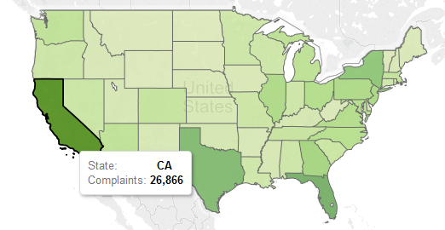
Consumer Complaints by U.S. State
Select count(complaint_id) as Complaint_Count , state from consumer_complaints where state <> "" group by state order by Complaint_Count desc;
Notes:
So, Firstly we found out the consumer complaints by each US state.
So, We listed the number of complaints for each state and found that California was the one having the maximum number of complaints, followed by Florida, Texas , New York and Georgia.
These top five states accounted for about 45% of the total complaints received by CFPB and other 45 states accounted for the rest.

Slide 16
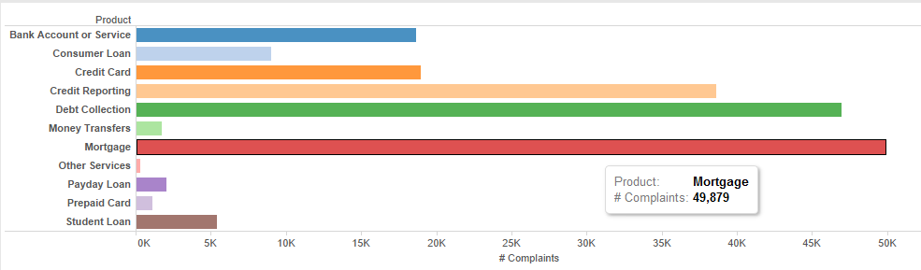
Products with Most Complaints
Select product, count(complaint_id) as complaints from consumer_complaints group by product order by complaints;
Notes:
Next is the Products with most complaints.
Here, products are like consumer loan, student loan, mortgage, etc.
As you can see, the product Mortgage accounts for the maximum number of complaints followed by Debt collection.
Also, we have found that In the past three months, Debt collection has become number one in terms of maximum complaints but overall Mortgage is still at top.

Slide 17
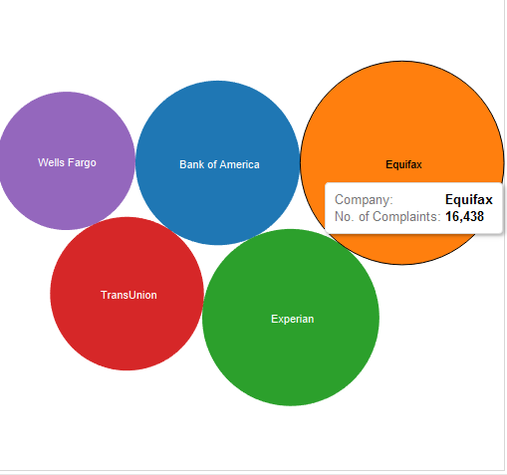
Top Five Companies with Most Complaints
Select Company, count(Complaint_id) as Complaint_Count from Consumer_Complaints group by Company order by Complaint_Count desc limit 5;
Notes:
Next, is top five companies with most complaints.
As you can see, Equifax holds the maximum share of complaints.
These companies are not only those which have the maximum complaints registered against them.
According to Wikipedia, these are also those companies with highest market share and highest customer base in US.

Slide 18
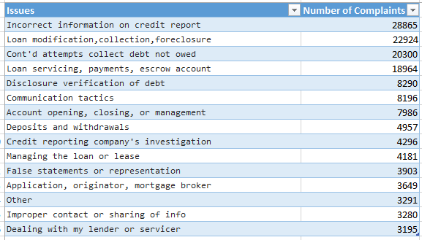
Most common Issues in complaints
Select issue, count(issue) as issues_of_thistype from consumer_complaints group by issue order by issues_of_thistype desc limit 15;
Notes:
Then, there are common issues in complaints.
These are the some of the most common issues regarding which the consumers have lodged complaints.
The top four are the most common ones.

Slide 19
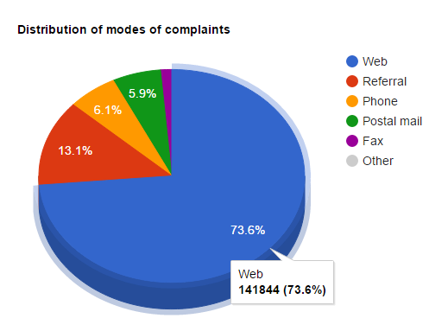
Mode of Complaints
Select Submitted_via, count(Complaint_ID) as count from Consumer_Complaints group by Submitted_via order by count desc Limit 6;
Notes:
Next, is Mode of complaints.
Since, Consumers can register complaints via Web, Phone, Referral, Postal Mail, Fax and others from which maximum complaints were registered via web i.e 73.6 %

Slide 20
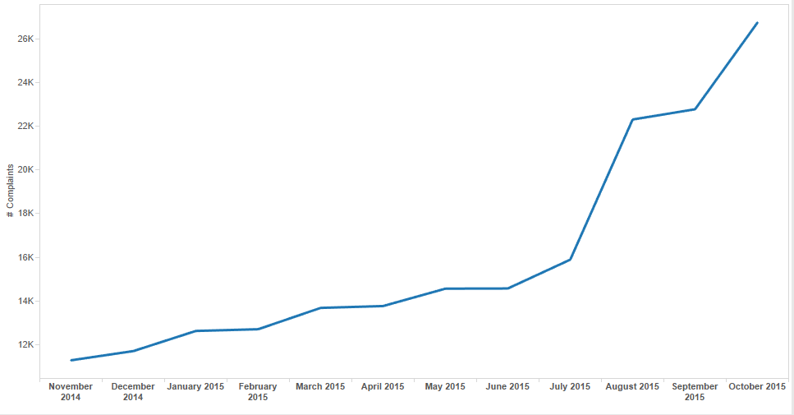
Trend in number of complaints over the last year
Select count(Complaint_ID) as counter , Month(Date_Received) as month from Consumer_Complaints where Date_Received > 2014-10-31 group by month order by counter desc limit 12;
Notes:
The above graph shows the trend in number of complaints over the past one year.
We can see that the number of complaints have increased tremendously after July 2015.
So, If we compare November 2014 to October 2015, we can see that there is more than twice increase in the number of complaints.

Slide 21
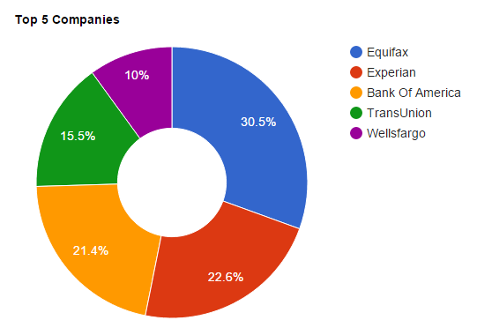
Companies that closed consumer complaints timely
Select Company, count(Complaint_ID) as count from Consumer_Complaints where Company_response_to_consumer <> 'In progress' and Company_response_to_consumer <> 'Untimely response' and Timely_response = 'Yes' group by Company order by count desc Limit 5;
Notes:
The top five companies that closed complaints in a timely manner with either explanation or relief.
Here also, Equifax holds the highest number of closed complaints.

Slide 22
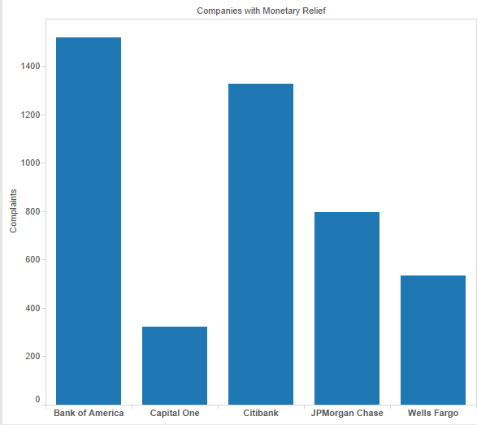
Top Companies that chose to close the complaints with monetary relief
select company , count(Complaint_ID) as counter from Consumer_Complaints where Company_response_to_consumer = "Closed with monetary relief" group by company order by counter desc limit 5;
Notes:
Closing the complaints with monetary relief either means complaint was very strong that company was forced to close it with monetary relief, or it shows that company was good at responding to complaints with customer satisfaction. These are the top five companies that had provided monetary relief for closing the complaints. Bank of America was the one which had provided the monetary relief for maximum number of complaints, followed by citibank and JPMorgan Chase.

Slide 23
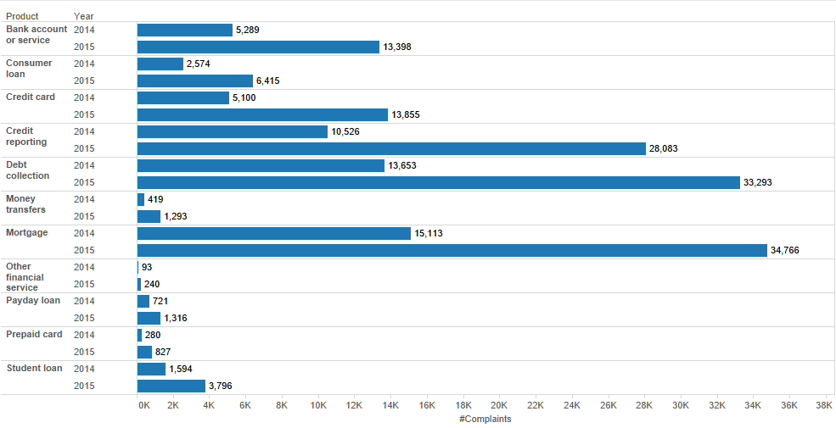
Comparison of product specific complaints for 2014 and 2015
Select product , count(complaint_id) as counter, substr(date_received,7,4) from consumer_complaints group by product,substr(date_received,7,4) order by product limit 50;
Notes:
Here, we have compared the product specific complaints for 2014 and 2015. We have found that almost all the complaints have doubled for each product. Lets take Mortgage, we can see that in 2014, there were approx 15000 complaints whereas in 2015 till now from january to October, complaints have reached 34000 mark which more than twice the previous year.

Slide 24
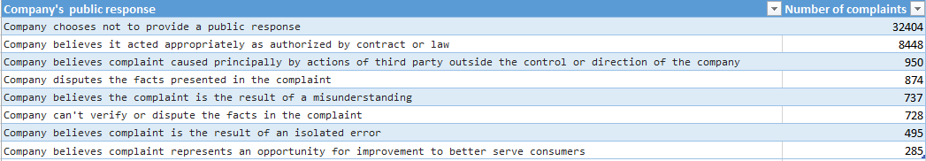
Most Common Response provided by Companies
select company_public_response, count(company_public_response) as types_of_publicresponse from consumer_complaints group by company_public_response order by types_of_publicresponse desc limit 9;
Notes:
Here, you can see the most common response provided by the companies. CFPB has placed no strict constraint regarding public response by the company and thus most companies tend not to provide a public response that result in “Company chooses not to privide a public response” response being the top. Barring that the most common public response is “Company believed it acted apporpriately as authorised by contract or law” between the company and the consumer.

Slide 25
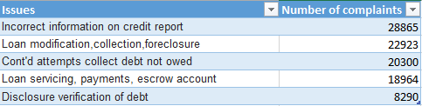
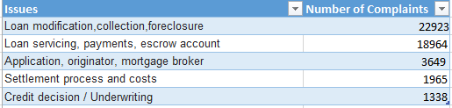
Issues with most complaints for different products
All products
Mortgage
select issue, count(Complaint_ID) as count from Consumer_Complaints group by issue order by count desc Limit 5;
select issue, count(Complaint_ID) as count from Consumer_Complaints where Product = 'Mortgage' group by issue order by count desc Limit 5;
Notes:
These figure shows the main issues with most of the complaints for different products. The top three Products are Mortgage, Debt Collection and Credit Reporting. We can see that their individual top issues that is (Loan modification,collection, foreclosure) for mortgage, (Continued attempts collect Debt not owed ) for debt collection, (incorrect information on credit report) for credit reporting, also come in top for issues for all products. This is happening because the number of complaints for the top three products are relatively close to each other.

Slide 26
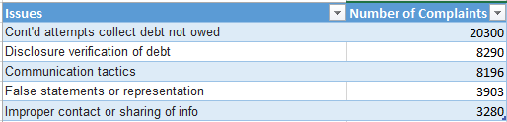
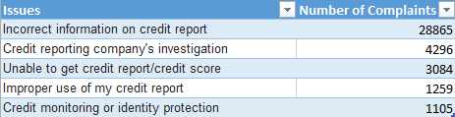
Debt Collection
Credit Reporting
select issue, count(Complaint_ID) as count from Consumer_Complaints where Product = 'Debt collection' group by issue order by count desc Limit 5;
select issue, count(Complaint_ID) as count from Consumer_Complaints where Product = 'Credit reporting' group by issue order by count desc Limit 5;

Slide 27
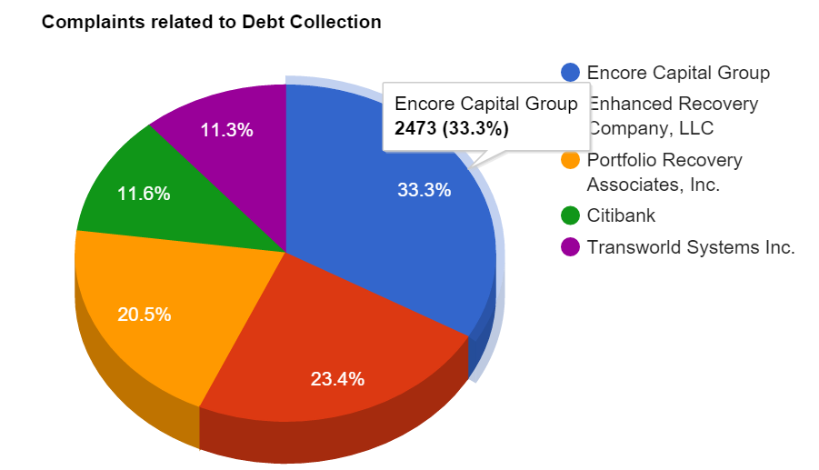
Companies with most complaints by product
select count(complaint_id) as counter , company from consumer_complaints where product='Debt collection' group by company order by counter desc limit 5;
Notes:
Here, you can see the top companies with most complaints for Debt Collection. Maximum complaints were registered against Encore Capital Group followed by Enhanced Recovery, LLC and Portfolio Recovery Associates, Inc.

Slide 28
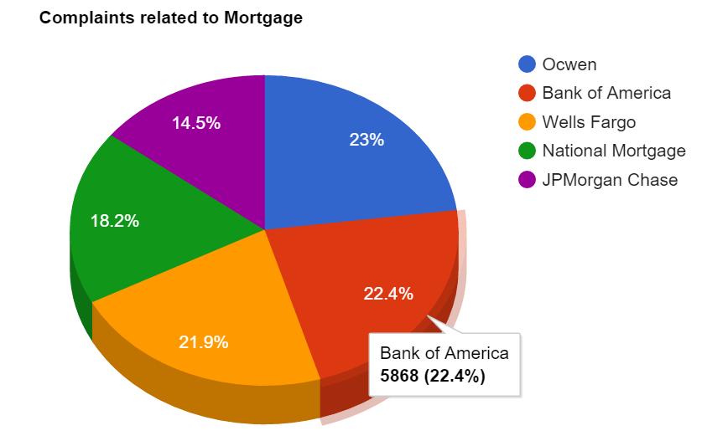
select Company, count(Complaint_ID) as count from Consumer_Complaints where Product = 'Mortgage' group by Company order by count desc Limit 5;
Notes:
Similarly for the Product mortgage, Ocwen has the maximum number of complaints. followed by Bank of America and Wells Fargo.

Slide 29
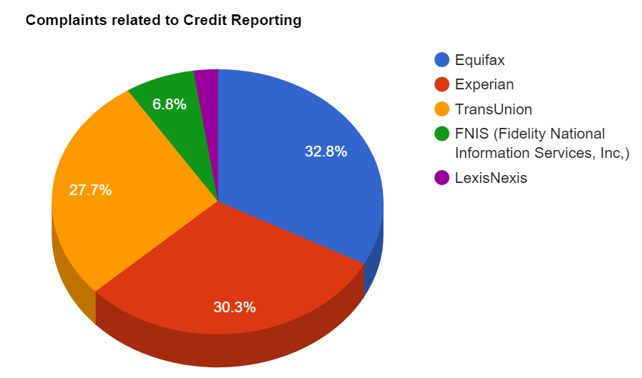
select Company, count(Complaint_ID) as count from Consumer_Complaints where Product = 'Credit reporting' group by Company order by count desc Limit 5;
Notes:
For credit Reporting, Equifax, experian and transunion are the top three companies, having the maximum share of complaints. Also, these three companies also account for the largest share of complaints for all the products.

Slide 30
PREDICTION USING NAIVE BAYES
Features : Product , Issue , Company
Target : Company Response
P(Target|Features) = P(Target) * P(Product|Target) * P(Issue|Target)*P(Company|Target)
The Target with max probablity will be output.
Notes:
We will be finding Probablity for every Target

Slide 31


Slide 32
Conclusion
Total Number of complaints (Jan 2014 to Nov 2015) : 1,92,644
Mortgage : Biggest trouble maker
Last 3 months: Debt Collection complaints increased and became number one, Overall Mortgage is still at first place
U.S. State with most complaints: California
Vast majority of Mortgage complaints fall into two categories:
Loan modification, collection, foreclosure and Loan servicing
payment and escrow account.
Financial Institute with most complaints registered against it: Equifax
Notes:
The CFPB has published 1,92,644 complaints from January 2014 to November 2015.
Mortgage problem ranks at number 1 in CFPB database of Consumer Complaints.
In the previous three months, Debt collection complaints have been increased and have become the number 1 problem to be published in CFPB database and Mortgage is at number 2. However, Overall mortgage is still at number 1.
California is the #1 U.S. State in which maximum complaints were registered.
Vast majority of Mortgage complaints fall into two categories which are Loan modification, collection, foreclosure and Loan servicing, payment and escrow account.

Slide 33


